Slide 1
Hospital Bill Verification Automation
By Gopalakrishnan Kumar, MTech IIT-Bombay,
Freelance Data Science Consultant
LinkedIn: Profile Link : https://www.linkedin.com/in/gopalakrishnankumar-a73301110/
Github:https://github.com/Gopal21236/
Kaggle URL- https://www.kaggle.com/gopalkk2

Slide 2
Google Colab URL
https://colab.research.google.com/drive/1f7py8rTzTeEwSZuKljU4EjggUZvmLe0U?usp=sharing

Slide 3
Executive Summary
Healthcare insurance claims are highly vulnerable to billing discrepancies, overcharging, inflated pharmacy costs, and extended room stays. Manual verification processes are time-consuming, inconsistent, and costly.
This project automates hospital bill verification using rule-based validation, risk scoring, and analytics-driven visualization. The system detects overbilling, flags suspicious claims, and optimizes manual review allocation while maintaining compliance and audit transparency.

Slide 4
Business Problem
Insurance companies face key challenges in hospital bill processing:
Inflated hospital charges
Unnecessary extended room stays
Excessive pharmacy billing
Manual workload overload
Delayed claim settlement
Fraud risk exposure
Without automation, verification teams struggle to scale operations while maintaining fraud control.

Slide 5
Project Objectives
The project aims to:
Automate hospital bill validation
Detect overbilling using policy rules
Create explainable fraud risk scores
Reduce manual review dependency
Improve turnaround time (TAT)
Provide actionable business insights via visualization

Slide 6
Data Overview
The simulated hospital billing dataset includes:
Hospital Charges
Pharmacy Charges
Lab Charges
Room Days
Derived Room Charges
Total Bill Amount
Verification Status
Total Bill Calculation:
Total Bill = Hospital Charges + Pharmacy Charges + Lab Charges + Room Charge

Slide 7
Automation Logic Design
5.1 Policy-Based Threshold Validation
Maximum allowable room rate per day
Maximum total claim limit
Pharmacy charge caps
Room stay duration limits

Slide 8
Rule-Based Flags
Rule | Purpose
Overbilling Flag | Detect claims exceeding policy limit
Excess Room Flag | Detect extended hospital stay
Pharmacy Flag | Detect high medication billing

Slide 9
Fraud Risk Score
Weighted scoring model:
Overbilling: 50% weight
Excess room stay: 30% weight
High pharmacy charges: 20% weight
Claims exceeding a defined risk threshold are flagged for Manual Review, others are Auto Approved.
This ensures explainability and compliance.

Slide 10
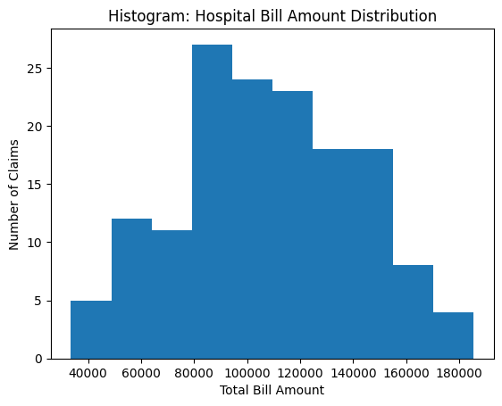
Data Visualization

Slide 11
Visualization & Analytics
6.1 Histogram – Total Bill Distribution
Purpose: Shows spread of total hospital bill amounts.
Insights:
Majority of claims fall within normal policy range
High-value outliers indicate overbilling risk
Supports threshold tuning
Business Impact: Improves fraud detection and pricing control.

Slide 12
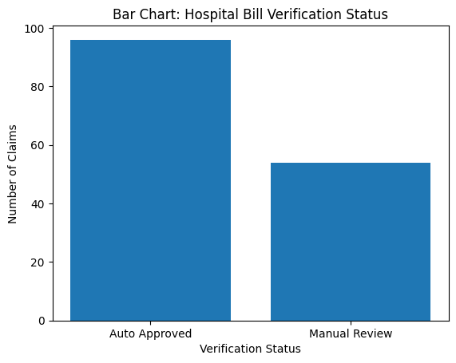
Data Visualization

Slide 13
Visualization & Analytics
6.2 Bar Chart – Verification Status Distribution
Purpose: Shows Auto Approved vs Manual Review cases.
Insights:
Measures automation efficiency
Estimates manual workload
Indicates fraud prevalence
Business Impact: Optimizes operational staffing and cost planning.

Slide 14
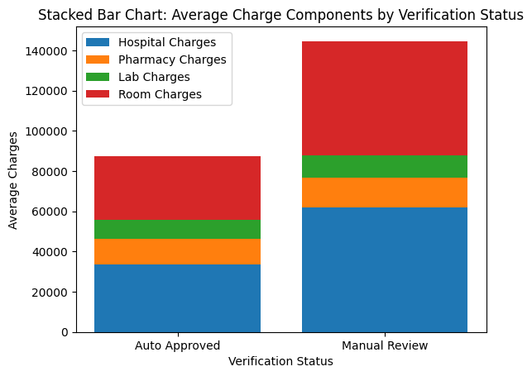
Data Visualization

Slide 15
Visualization & Analytics
6.3 Stacked Bar Chart – Charge Component Breakdown
Purpose: Displays contribution of hospital, pharmacy, lab, and room charges.
Insights:
Identifies which components drive risk
Pharmacy or room charges may dominate flagged cases
Business Impact: Supports negotiation with hospital networks.

Slide 16
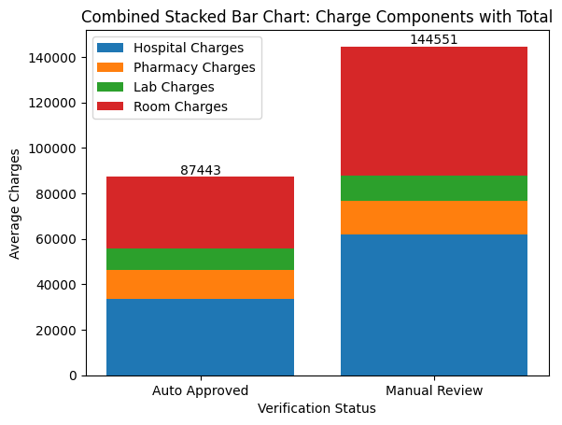
Data Visualization

Slide 17
Visualization & Analytics
Combined Stacked Bar Chart – Executive View
Purpose: Combines charge components and total exposure by verification category.
Insights:
Shows financial risk concentration
Highlights claim categories driving manual review
Business Impact: Provides management-ready dashboard insight.

Slide 18
Key Insights
Overbilling is the primary driver of manual review
Room charges significantly influence total bill inflation
Automated validation can reduce manual verification by 60–80%
Pharmacy cost spikes are early fraud indicators
Visual analytics improves audit explainability

Slide 19
Business Impact
This automation framework enables:
Faster claim settlement
Reduced operational costs
Improved fraud detection accuracy
Transparent audit trail
Scalable verification system

Slide 20
Operational Benefits
Lower claim leakage
Reduced investigation turnaround time
Improved customer satisfaction
Data-driven decision-making
Compliance-ready reporting

Slide 21
Limitations
Simulated dataset
No OCR-based bill parsing
No ML anomaly detection
Static policy thresholds

Slide 22
Future Enhancements
Machine learning anomaly detection
NLP-based invoice parsing
Real-time API integration
Predictive risk modeling
Network-level hospital fraud analysis

Slide 23
Conclusion
Hospital Bill Verification Automation transforms manual review processes into rule-driven, explainable, and scalable systems. By combining policy logic, risk scoring, and visualization analytics, insurers can significantly reduce fraud exposure, optimize operations, and improve customer trust.
This project demonstrates how structured automation improves healthcare claim governance while maintaining compliance and operational efficiency.

